Slide 1

BOOSTING ALGORITHM REGRESSION

Slide 2

What is Gradient Boosting?
Gradient Boosting is an ensemble learning method that combines several weak learners (often shallow decision trees) into a strong learner. It works on the principle that by sequentially training new models, each one tries to correct the errors made by the previous model. Here are the key points about Gradient Boosting:

Slide 3
TYPE OF BOOSTING ALGORITHM REGRESSION
Ada Boosting (Adaptive Boosting)
XG Boosting (eXtreme Gradient Boosting)
LG Boosting (Light Gradient Boosting Machine)

Slide 4
Ada Boost (Adaptive Boosting)

Slide 5
What is Ada Boost?
AdaBoost is an ensemble learning technique used for both classification and regression tasks.
It combines multiple weak learners (often decision trees) to create a strong classifier.
The idea is to iteratively train weak models, giving more weight to misclassified samples in each iteration.

Slide 6
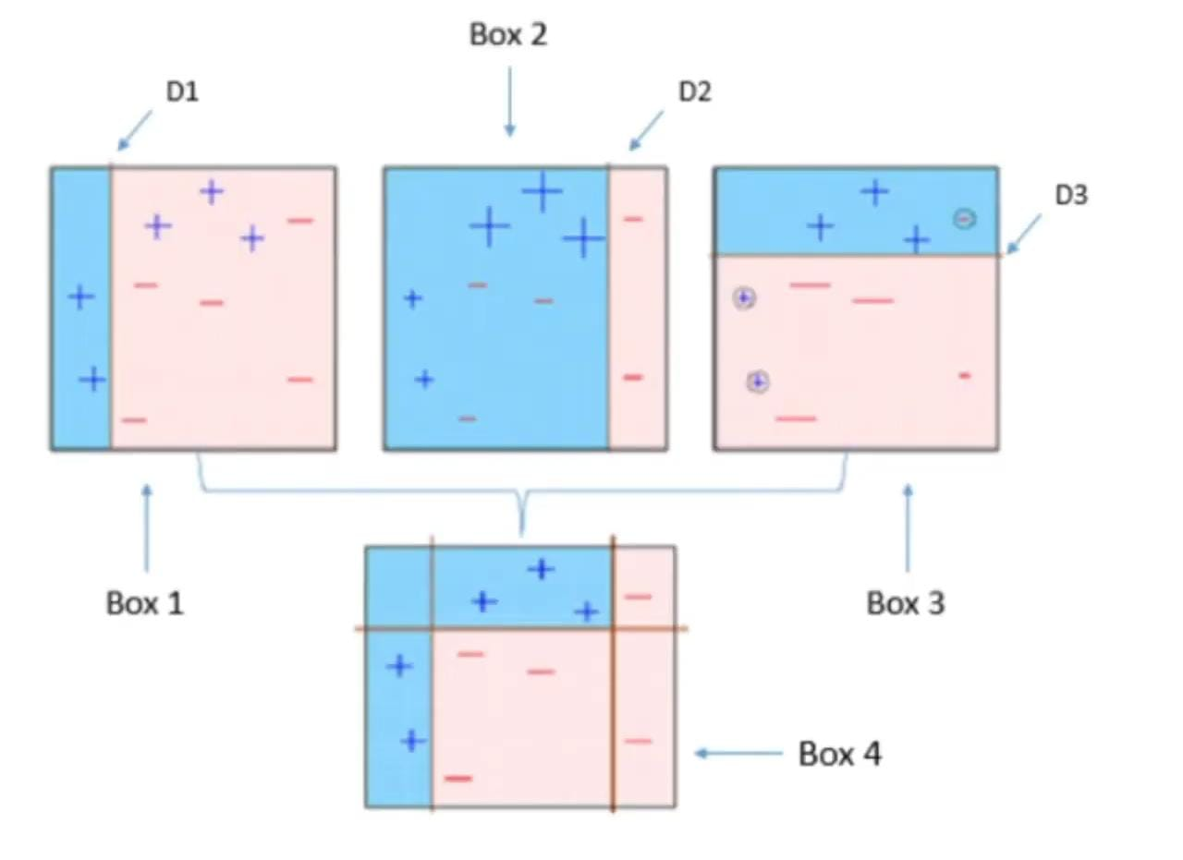
How Does AdaBoost Work?
AdaBoost diagram
Initialize the dataset with equal weights for all data points.
Train the first weak model (e.g., a decision tree) on the weighted data.
Identify misclassified points and increase their weights.
Train the next weak model, focusing on the misclassified points.
Repeat this process for a specified number of iterations.
Combine the weak models to create the final strong model.

Slide 7
Advantages of AdaBoost:
Improved Accuracy: AdaBoost combines weak models’ predictions to enhance overall accuracy.
Robustness to Overfitting: It reduces overfitting by reweighting misclassified points.
Handling Imbalanced Data: AdaBoost can handle imbalanced datasets effectively.
Interpretability: It breaks down the decision process into steps.

Slide 8
XG Boosting (eXtreme Gradient Boosting)

Slide 9
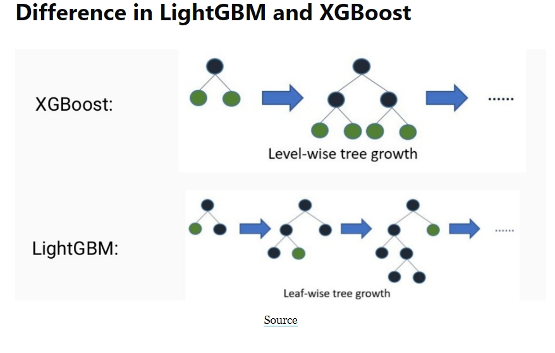
XG Boosting (eXtreme Gradient Boosting)
What is XGBoost?
XGBoost is an optimized distributed gradient boosting library designed for efficient and scalable training of machine learning models.
It is an ensemble learning method that combines the predictions of multiple weak models to produce a stronger prediction.
XGBoost stands for “Extreme Gradient Boosting.”
It has become one of the most popular and widely used machine learning algorithms due to its ability to handle large datasets and achieve state-of-the-art performance in tasks such as classification and regression.

Slide 10
How Does XGBoost work?
Initialize the model with a simple decision tree (a weak learner).
Calculate the residuals (errors) based on the initial predictions.
Train a new decision tree to predict the residuals.
Add the new tree’s predictions to the previous ones.
Repeat steps 2-4 until a specified number of trees are built.
Combine the predictions from all trees to create the final model.

Slide 11
Advantages of XGBoost:
Exceptional predictive performance: XGBoost consistently outperforms other algorithms.
Scalability: It handles large datasets efficiently.
Flexibility: Suitable for regression, classification, and ranking tasks.
Feature importance: XGBoost provides insights into feature importance.

Slide 12
LG Boosting (Light Gradient Boosting Machine)

Slide 13
What is LightGBM?
LightGBM is an ensemble learning framework, specifically a gradient boosting method.
It constructs a strong learner by sequentially adding weak learners in a gradient descent manner.
It is designed for efficiency, scalability, and accuracy.
LightGBM is based on decision trees and aims to improve model efficiency while reducing memory usage.

Slide 14
How LightGBM Works
Leaf-Wise Tree Growth:
LightGBM creates decision trees that grow leaf-wise. This means that given a condition, only one leaf is split, depending on the benefit.
Leaf-wise trees can sometimes overfit, especially with smaller datasets. To prevent overfitting, you can limit the tree depth.
Histogram-Based Binning:
LightGBM uses a histogram-based method to bucket data into bins.

Slide 15
How LightGBM Works
Instead of using every data point, it iterates over the bins, calculates the gain, and splits the data.
This approach can be optimized for sparse datasets as well.
Exclusive Feature Bundling:
LightGBM combines exclusive features to reduce dimensionality and speed up processing.
By bundling related features, it can improve efficiency during training.

Slide 16
Advantages of LightGBM:
Speed: LightGBM is fast due to its efficient algorithms.
Accuracy: It achieves high accuracy by optimizing the learning process.
Scalability: Supports parallel, distributed, and GPU learning.
Memory efficiency: Techniques like GOSS help reduce memory usage.

